Slide 1


Building Rich User Interaction with Knockout JS
Ian Robinson
Enliven

Slide 2

Ian Robinson
github.com/irobinson
@irobinson

Slide 3
Agenda
Introduction
Key Knockout Concepts
How? Live examples
DotNetNuke 6.2
User File Manager Example

Slide 4
Overview
Why JavaScript Frameworks?
https://github.com/addyosmani/todomvc
Backbone, Spine, Ember, Knockout
Structure provided by proven patterns (MVC, MVVM)
Knockout
MVVM
Model = Data (e.g. service)
View = UI (e.g. html)
ViewModel = Code representation of data (e.g. JS object)

Slide 5

Key Concepts: Declarative Bindings
Declarative Bindings
What and where, not how

Slide 6
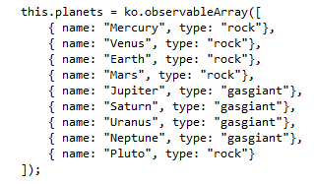
Key Concepts: Automatic UI Refresh
Automatic UI Refresh
Your data drives the UI
Manipulate your data, not the DOM

Slide 7
Key Concepts: Dependency Tracking
Dependency Tracking
Create relationships between data
Observables, Observable Arrays, and Computed Observables

Slide 8
Key Concepts: Templating
Templating
Native (e.g. foreach, if)
String Based (third-party, e.g. Underscore, jQuery.tmpl)

Slide 9
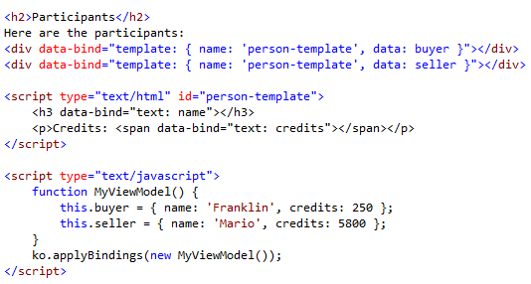
Named Template

Slide 10
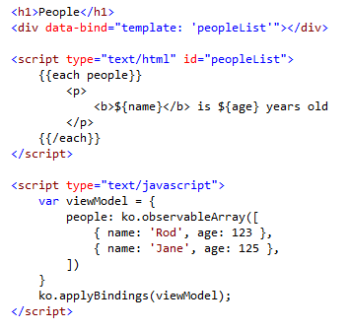
External Template Engine

Slide 11
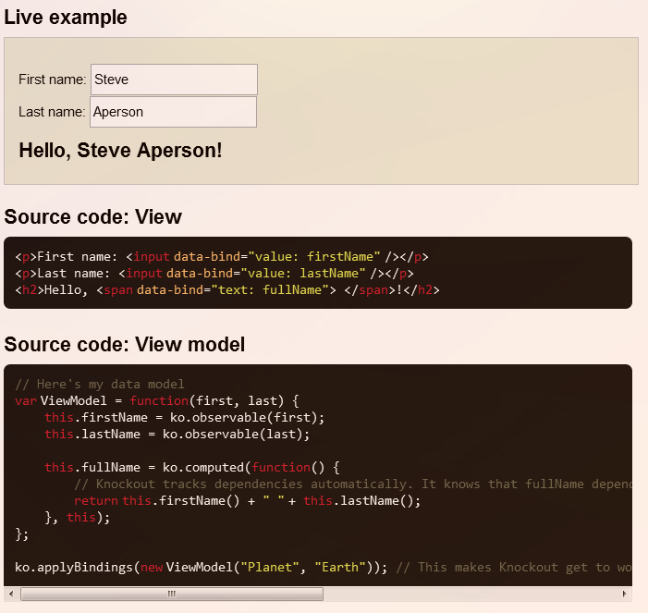
Live Examples

Slide 12
Knockout in DotNetNuke 6.2
Shipped with DotNetNuke
/resources/shared/scripts/knockout.js
Used throughout the new modules
I implemented it in User File Manager
Templating
DNN Service API
Custom bindings
Computed bindings
jQuery Plugin / Reusable Component

Slide 13
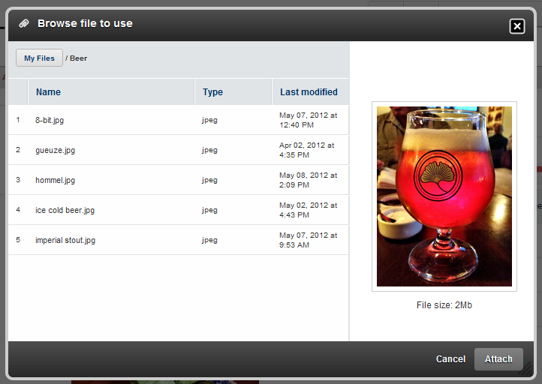
User File Manager

Slide 14
Thank you!
Ian Robinson
Co-Founder & CTO Enliven ian@enlivenstudio.com
@irobinson | @enlivenhq

Slide 15

















Thanks to all our Generous Sponsors!

